Slide 1

राष्ट्रीय प्रौद्योगिकी संस्थान पुदुच्चेरी
NATIONAL INSTITUTE OF TECHNOLOGY PUDUCHERRY
KARAIKAL – 609 609
Final Year project - First Review Meeting
AI Based Design for Frequency Selective Surface (FSS)
Project Guide
Dr. Boopathi Rani R
Assistant Professor,
Depatment of ECE,
NIT Puducherry, Karaikal,
India
Presented by
KAPA ADHEESHWAR REDDY
Reg No: EC21B1023
SADHU POORNA SAI
Reg No:EC21B1043
SANAPALA CHANDRA SEKHAR
Reg No:EC21B1044
B.TECH Department of ECE,
NIT Puducherry, Karaikal,
India

Slide 2
Introduction:
What is Frequency Selective Surfaces (FSS)?
Frequency Selective Surfaces (FSS) are specialized structures used in modern wireless communication systems.
They play a crucial role in filtering, controlling, and modifying electromagnetic waves.
Applications of FSS:
FSS is used to enhance the performance of antennas by filtering specific frequencies.
FSS helps in shielding electronic devices from unwanted electromagnetic interference.
FSS structures are integral in managing signal propagation and improving overall system efficiency.
Challenges in FSS Design:
Traditional Design Methods: Designing FSS typically involves iterative processes that are computationally expensive and time-consuming.
Complexity: Achieving the desired electromagnetic properties through traditional methods requires significant expertise and resources.

Slide 3
Problem Statement:
The current challenge lies in designing Frequency Selective Surfaces (FSS) to meet specific performance criteria through traditional methods, which require significant computational resources and expertise. Additionally, extracting control parameters for FSS and reducing dataset requirements in AI-driven design processes present further difficulties. Therefore, this project seeks to develop AI models that address these challenges by enhancing design efficiency, accuracy, and Less computation time.
Objectives:
Develop an AI-Based FSS Design Framework: Implement an efficient design method for Frequency Selective Surfaces (FSS) using a deep neural network-based Forward Prediction Network (FPN) to predict transmission coefficients, thereby reducing reliance on computationally expensive full-wave simulations.
Enhance Optimization Efficiency: Integrate the Improved Particle Swarm Optimization (IPSO) algorithm with the FPN to iteratively optimize FSS structural parameters, achieving faster convergence with high accuracy.
Improve Design Accuracy: Achieve accurate FSS design results by minimizing errors in transmission coefficients at key frequency points, with deviations of less than 1 dB.
Reduce Computational Time: Increase design efficiency by over 99% compared to traditional methods, making FSS design faster and more adaptable for practical applications.

Slide 4
Methodology:
The project will follow a structured approach to tackle the design challenges associated with FSS using AI:
Generative Models for Design: A generative model will be developed and trained on existing FSS datasets to automatically generate designs with desired electromagnetic characteristics. The model will be optimized to produce high-quality results while reducing computational time.
Dataset Reduction Techniques: Data reduction strategies will be employed to minimize the dataset size needed for training while preserving essential data features, thereby reducing computational load without sacrificing performance.[4]
Optimization Techniques: The goal is to identify the set of parameters that results in the best possible performance of the model. the model not only becomes more accurate but also more efficient, making it better suited to real-world applications.[3]
Hybrid Modelling: A combination of traditional transfer functions and neural networks will be used to model complex FSS designs. This hybrid approach will balance the strengths of both techniques to produce more accurate and efficient models.

Slide 5
Model Training:
We are converting the dataset into more accessible way. We are using the Regression Models (Linear regression and Ridge regression) and train them using the given Dataset.
Model Assessment:
Predict on Test Data → Calculate MSE and R2 Score →Plot the Actual Values and Predicted Values using the Matplot → Comparing both the plots → Assess Model Performance
AI MODEL
FOR
S21 PREDICTION
Input
Output
Frequency
S21 VALUE
Fig(1). Block Diagram of Model 1
Input
AI MODEL
FOR LENGTH PREDICTION
Frequency
Output
LENGTH
S21 VALUE
Fig(2). Block diagram of Model 2

Slide 6
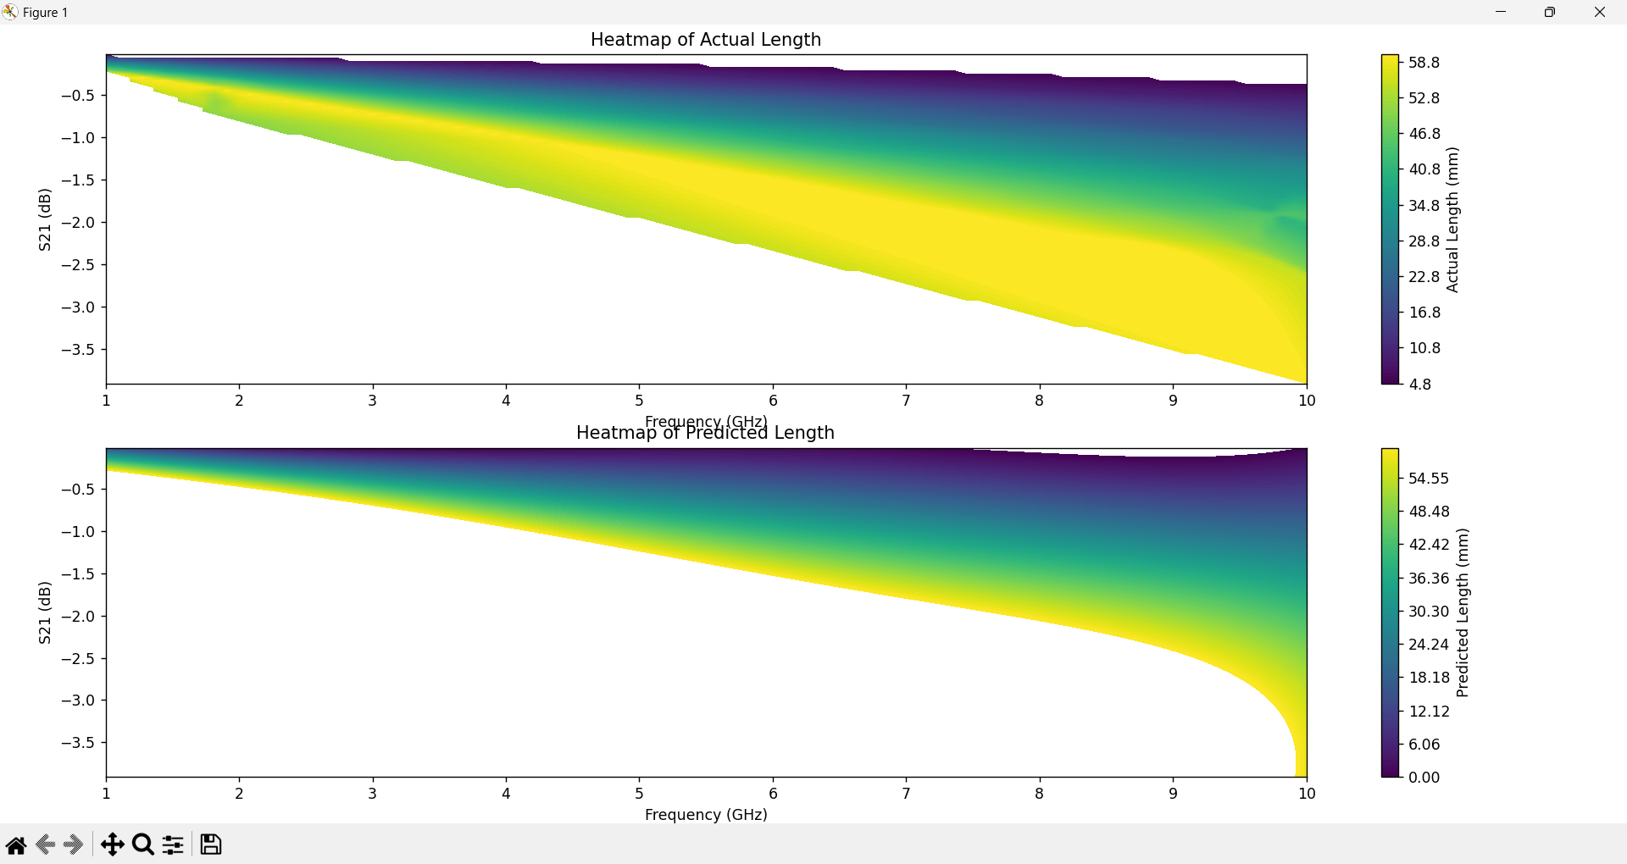
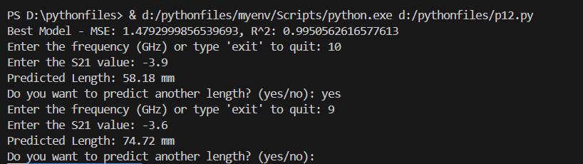
Design of MicroStripline
Key Outcomes :
The predicted length of the microstrip line represents the maximum achievable length based on the input frequency and S21 values.
Using Ridge Regression it enhances model accuracy by capturing non-linear relationships. It includes detailed parameter tuning with GridSearchCV, better data handling, and visualization through heatmaps.
Input
AI MODEL
FOR LENGTH PREDICTION
Frequency
Output
LENGTH
S21 VALUE
Fig(2). Block diagram of Model 2
6
Fig(5). Output of Model 2B
Fig(5). Heatmap visualization of Frequency vs S21 for Actual length and predicted length values

Slide 7
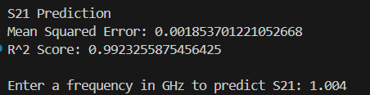

Results
Model 1A & 1B: Prediction of S21 Values
Performance :
MSE and R2 Score of the Model 1B are in the acceptable limits.
Key Outcomes :
The Plots of both Actual and Predicted values are similar to each other .Hence the predicted values
are more accurate.
Ridge Regression generally leads to a more reliable model by preventing overfitting, increasing
stability, and improving performance, especially with complex or high-dimensional data.
Output:
S21 Prediction
Mean Squared Error: 81.13142698 (1A)
R^2 Score: 0.63256874 (1A)
Dataset preview:
Freq [GHz] dB(S(1,1)) [] dB(S(2,1)) []
0 1.000 -37.537533 -0.163039
1 1.001 -37.533110 -0.163166
2 1.002 -37.528670 -0.163293 Fig(3). Output of model 1B
S21 Prediction
Mean Squared Error: 0.001853701 (1B)
R^2 Score: 0.99232558 (1B)
Enter a frequency in GHz to predict S21: 1.004 (1B)
For Frequency = 1.004 GHz:
Predicted S21 = -0.10723295347750378

Slide 8
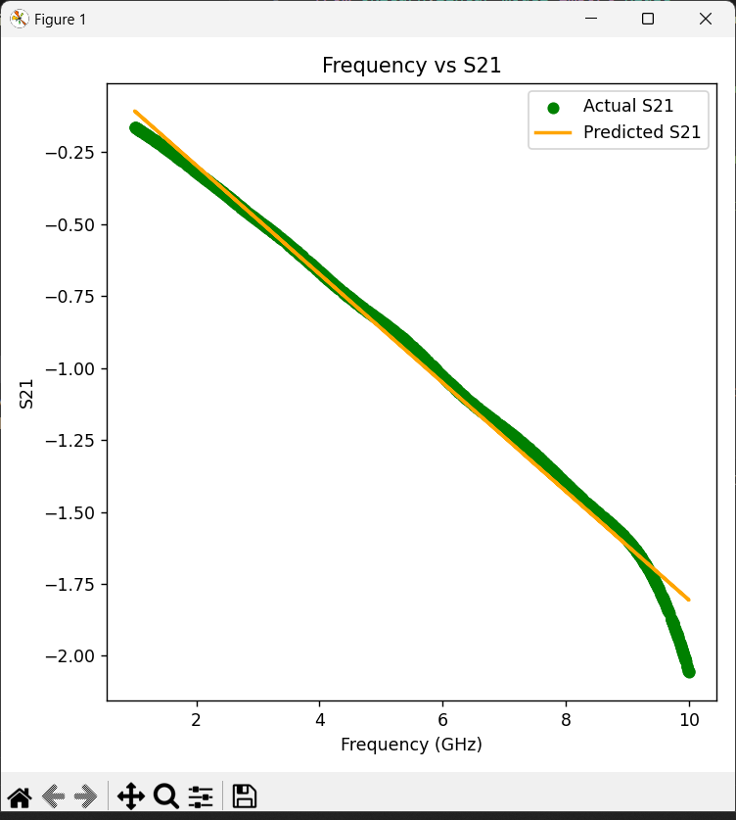
Fig(4). Visualization of Frequency vs S21 of Actual and Predicted Values(1B)

Slide 9
Model 2A & 2B: Prediction of Length Values
Performance :
MSE and R2 Score of the Model are in the acceptable limits.
Key Outcomes :
The predicted length of the microstrip line represents the maximum achievable length based on the input frequency and S21 values.
Using Ridge Regression it enhances model accuracy by capturing non-linear relationships. It includes detailed parameter tuning with GridSearchCV, better data handling, and visualization through heatmaps.
Output:
MSE:65.216489 R^2:0.798421 (2A)
Best Model - MSE: 1.4792999856539693(2B)
R^2: 0.9950562616577613(2B)
Enter the frequency (GHz) or type 'exit' to quit: 10
Enter the S21 value: -3.9
Predicted Length: 58.18 mm
Do you want to predict another length? (yes/no): yes
Enter the frequency (GHz) or type 'exit' to quit: 9
Enter the S21 value: -3.6
Predicted Length: 74.72 mm
Fig(5). Output of Model 2B

Slide 10
Fig(5). Heatmap visualization of Frequency vs S21 for Actual length and predicted length values

Slide 11
Conclusion:
1. Model Performance Improvement: The switch from Linear Regression to Ridge Regression with Polynomial Features significantly enhanced model accuracy by better capturing non-linear relationships in the data, reducing both Mean Squared Error (MSE) and improving R² scores.
2. Overfitting Reduction: Ridge Regression successfully mitigated overfitting issues observed in the linear regression models, leading to more stable and reliable predictions, particularly when dealing with complex or high-dimensional data.
3. Enhanced Data Handling: The updated approach allowed for a more sophisticated transformation of the input features, enabling the model to better handle complex data patterns and interactions.
5. Improved User Interaction: The integration of continuous user input handling in a separate thread allowed for real-time predictions, making the system more interactive and user-friendly, and further demonstrating the practical applicability of the model.

Slide 12
References
N. Calik, M. A. Belen, P. Mahouti, and S. Koziel, “Accurate Modeling of Frequency Selective Surfaces Using Fully-Connected Regression Model With Automated Architecture Determination and Parameter Selection Based on Bayesian Optimization,” IEEE Access, vol. 9, pp. 38396–38410, 2021, doi: 10.1109/ACCESS.2021.3063523.
J. Shi et al., “Control Parameter Extraction Model for Reconfigurable Bandpass Filter Based on Bayesian Optimized Multiple-Output XGBoost,” IEEE Microw. Wirel. Technol. Lett., vol. 34, no. 3, pp. 263–266, Mar. 2024, doi: 10.1109/LMWT.2023.3343095.
Q. Ding, G. Wan, N. Wang, and X. Ma, “Dataset Shrinking for Accelerated Deep Learning-Based Metamaterial Absorber Design,” IEEE Microw. Wirel. Technol. Lett., vol. 33, no. 8, pp. 1111–1114, Aug. 2023, doi: 10.1109/LMWT.2023.3276892.
T. Hastie, The Elements of Statistical Learning: Data Mining, Inference, and Prediction. 2009. doi: 10.1007/978-0-387-84858-7.

Slide 13
Future Work
Model Refinement : Further refinement of the models is necessary to enhance the accuracy of FSS design predictions.
Next Phase : The next phase will involve designing and analyzing an existing Frequency Selective Surface to further validate and improve the models.
Thank You

